Slide 1


+
BOT FRAMEWORK AND XAMARIN.FORMS APPLICATION INTEGRATION
USING
DIRECT LINE CLIENT API

Slide 2
Your Speaker
BRYAN ANTHONY GARCIA
Works at Avanade
Mobile Developer
Xamarin.Forms, UWP, HoloLens, Web, and Azure solutions
Graphic Designer

Slide 3



Direct Line API
DIRECT LINE CLIENT API
BOT
CLIENT APPLICATIONS

Slide 4
Direct Line API RESTful Interface
Authorization
Create Conversation
Send Message
Get Reply
Refresh Conversation

Slide 5
Authentication – Secret and Token
Secret
Application-wide key to secure the direct line channel.
Can access any conversation, and create tokens. Secrets do not expire.
Token
Optional
Conversation-specific key.
Tokens expire in 30 minutes, but can be refreshed.

Slide 6
Authentication –W Secrets and Tokens
This operation is optional. Use this step if you want to prevent clients from accessing conversations they aren't participating in.
Request:
POST directline.botframework.com/api/tokens/conversations
Authorization: [BotConnector or Bearer] <secret key here>
Response:
HTTP/1.1 200 OK
RCurR_XV9ZA.cwA.BKA.iaJrC8xpy8qbOF5xnR2vtCX7CZj0LdjAPGfiCpg8qbOF5xPGfiCpg4Fv0y8qqbxn ←- TOKEN

Slide 7
Geographic Direct Line endpoints
Use Geographic-specific endpoints to ensure your traffic ends up in exactly the right datacenter. A great way to avoid sending your packets on an accidental trans-Atlantic or trans-Pacific journey!
directline.botframework.com routes your client to the nearest datacenter.
This is the best option if you do not know where your client is located.
asia.directline.botframework.com routes only to Direct Line servers in Eastern Asia.
europe.directline.botframework.com routes only to Direct Line servers in Europe.
northamerica.directline.botframework.com routes only to Direct Line servers in North America.

Slide 8
Create Conversation
Direct Line conversations are explicitly opened by clients and may run as long as the bot and client participate (and have valid credentials. More than one client may connect to a given conversation. If successful, the Direct Line service replies with a JSON object containing a conversation ID and a token.
Request:
POST directline.botframework.com/api/conversations/
Authorization: [BotConnector or Bearer] <secret key or token here>
Response:
{
"conversationId": "abc123",
"token“ : "RCurR_XV9ZA.cwA.BKA.iaJrC8xpy8qbOF5xnR2vtCX7CZj0LdjAPGfiCpg4Fv0y8qbOF5xPGfiCpg4Fv0y8qqbOF5x8qbOF5xn",
"expires_in": 1800
}

Slide 9
Send Message
No data is returned in this call. If the bot generates an error, that error will trigger an HTTP 500 error in the POST /api/conversations/{conversationId}/messages call.
Request:
POST directline.botframework.com/api/conversations/<conversationId>/messages
Authorization: [BotConnector or Bearer] <secret key or token here>
{ "text": "hello",
"from": "user1“ }
Response:
HTTP/1.1 204 No Content

Slide 10
Get Bot Replies
Clients issue GET calls to the /api/conversations/{conversationId}/messages endpoint to get all messages inside the conversation. Optionally supply a watermark indicating the most recent message seen.
Request:
GET directline.botframework.com/api/conversations/<conversationId>/messages
Authorization: [BotConnector or Bearer] <secret key or token here>
Response:
{
"messages": [{ "conversation": "abc123", "id": "abc123|0000", "text": "hello", "from": "user1" }, { "conversation": "abc123", "id": "abc123|0001", "text": "Nice to see you, user1!", "from": "bot1" }], "watermark": "000002“
}

Slide 11
Refresh Conversation
Conversations or tokens are valid for 30 minutes from the time they are generated. Cannot be refreshed if it’s already expired.
Request:
GET directline.botframework.com/api/tokens/{conversationId}/renew
Authorization: [BotConnector or Bearer] <secret key or token here>
Response:
HTTP/1.1 200 OK

Slide 12

Prism MVVM
An MVVM framework for building loosely coupled, maintainable, and testable XAML applications in WPF, Windows 10 UWP, and Xamarin Forms.
https://github.com/PrismLibrary/Prism

Slide 13
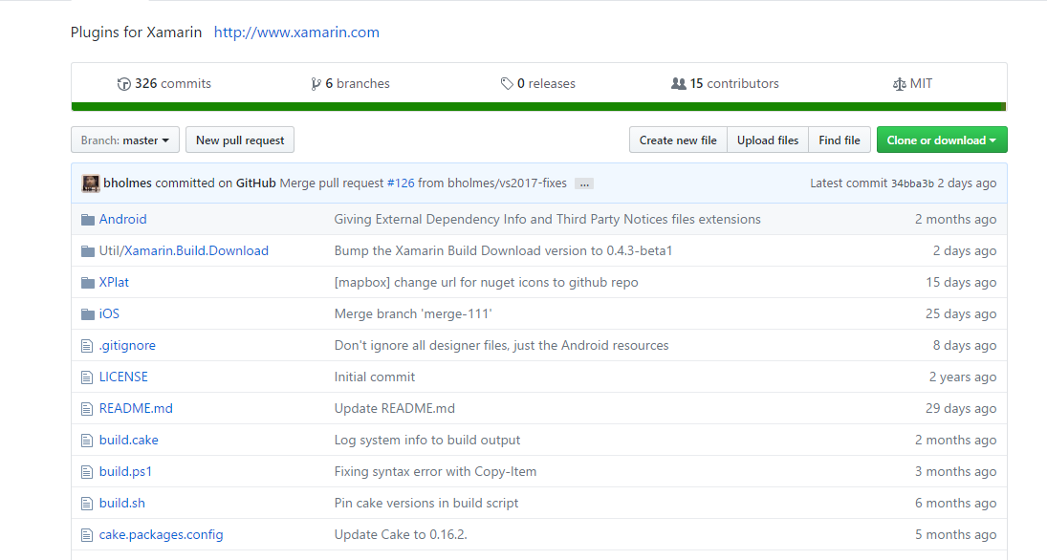
Xamarin Plugins
Collection of open source components (including bindings and plugins) created by Xamarin and others in the community.
https://github.com/xamarin/XamarinComponents

